Slide 1

YUSAK SETIAWAN

Slide 2

Dart Language
Why... Why… Dart ?
Installation
IDE
Data Types
Variables
Operators
Conditions
Loops
Unit Testing

Slide 3
Why Dart ?
Modern Language (String literal, Map, Tuple).
Easy to move to another languages such as JAVA, C#, Javascript.
Strongly typed programming language.
Object Oriented Language.
Compiled based language.
Interoperable (Front End + Back End, Web, Mobile)
Supported by well known IDE, Android Studio, Code, Atom, etc.
Made by well known company (Google)

Slide 4
Installation (Preparation)
WINDOWS
https://gekorm.com/dart-windows/
MAC
https://dart.dev/get-dart (choose mac tab)
Installation Check
Type dart --version

Slide 5
IDE (Integrated Development Environment)
Visual Studio Code
Android Studio
Online Editor (Dartpad), https://dartpad.dartlang.org
IntelliJ
Sublime
Atom

Slide 6
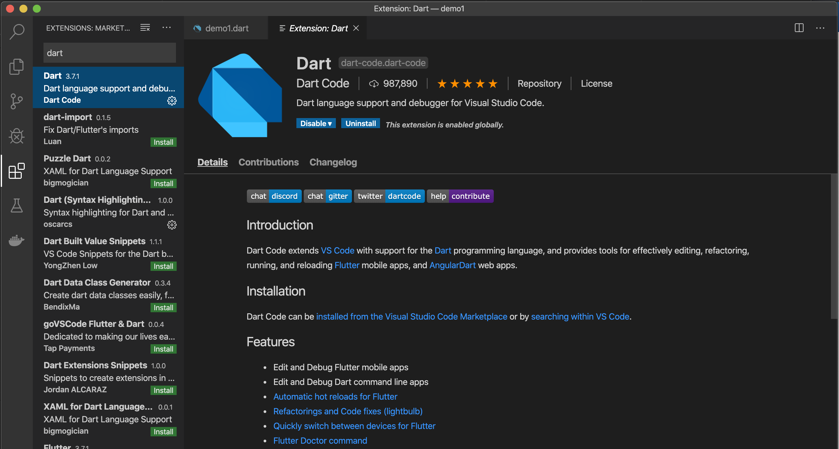
Visual Studio Code or Code
Install dart plugins for Code.

Slide 7
Data Types
Numbers
Integer (int)
Double (double)
Strings
String
Booleans
bool
Lists & Maps
Dynamic Types

Slide 8
Variables
Menampung nilai
Syntax
String name = ‘My Name is Budi’;
int panjang = 10;
double radius = 1.0;
var luas = 100;
final & const keyword / reserved word
final double pi = 3.14;
const double pi = 3.14;

Slide 9
Operators
Arithmatic Operatos
+ - * / ~/ ++ --
Equality and Relational Operators
> < >= <= == !=
Type test Operators
Bitwise AND ( var1 & var2 )
Bitwise OR ( var1 | var2 )
Bitwise XOR ( var1 ^ var2 )
Bitwise NOT ( ~var1 )
Left shift ( a << b )
Right shift ( a >> b )

Slide 10
Operators (Lanjutan)
Assignment Operator
= ??= += -= *= /=
Logical Operator
&& || !
Conditional Operator
Condition ? expr1 : expr2

Slide 11
Conditions
if statement
if…else statement
switch…case statement

Slide 12
Loops
Terdefinisi
for
for…in
Tidak terdefinisi
while
do…while

